Slide 1
Acceleration Data Structures

Slide 2
Lecture Roadmap
Introduction/Motivation
Bounding Volume Hierarchy
Grid/Voxel
Octrees
kd-Trees/ Surface Area Heuristic
Binary Space Partition Trees
Advanced Techniques

Slide 3
Motivation
Lots of things can slow down the rendering process
Many objects in the scene
Larger viewport
Complicated rendering techniques
Etc.
In non-trivial applications we can have very crowded scenes, so how can we quickly scan every object for rendering as our scenes increase in size?

Slide 4
Acceleration algorithms will always be needed
In real-time rendering , we have at least four performance goals: more frames per second, higher resolution and sampling rates, more realistic materials and lighting , and increased geometrical complexity.
Describing and evaluating an object’s material can be computationally complex. Modeling the interplay of light and surface can soak up an arbitrarily high amount of computing power.
There is no real upper limit on scene complexity. Neither z-buﬀering nor ray tracing can handle such models without the use of techniques to reduce the sheer number of computations needed.

Slide 5
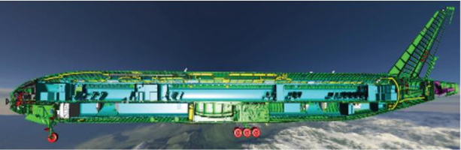
Large Scene Complexity
The rendering of a Boeing 777 includes 132,500 unique parts and over 3,000,000 fasteners, which yields a polygonal model with over 500,000,000 polygons.

Slide 6
Spatial Data Structures
A spatial data structure is one that organizes geometry in some n-dimensional space. These data structures can be used to accelerate queries about whether geometric entities overlap. Such queries are used in a wide variety of operations, such as culling algorithms, during intersection testing and ray tracing, and for collision detection.
The organization of spatial data structures is usually hierarchical. Thus, the structure is nested and of a recursive nature. Geometry is referenced by some of the elements in this hierarchy. Some common types of spatial data structures are bounding volume hierarchies, variants of binary space partitioning (BSP) trees, quadtrees, and octrees.
Notes:
Panorama: 全景画; 全景照片

Slide 7
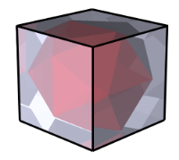
Bounding Volumes
Extents and bounding volumes
Enclose complex objects in simpler ones
Simpler = spheres, cuboids
If bounding volume isn’t visible, neither is object inside it!
To increase efficiency, put multiple objects into one volume
How does this speed up ray tracing?
Quick reject: check ray against bounding volume first
Quicker reject: check group of rays (frustum) against bounding volume of object
Simple to implement and can offer noticeable speedups
Even simpler to implement: Axis-Aligned Bounding Boxes (AABBs)
An AABB is a cuboid such that each edge is parallel to either the x, y, or z axis
Calculate by finding the min and max X/Y/Z for each vertex
Works well if object has tight bounding box, not so great for the 10-story crane working on the new performing arts center

Slide 8
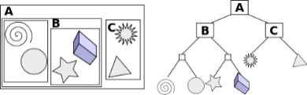
Bounding Volume Hierarchy (1/3)
A technique for organizing the entire model:
Group bounding volumes in an encompassing bounding volume to create a tree hierarchy
Bottom-up construction
Repeatedly group bounding volumes of nearby objects together until entire scene is bounded
Finding objects that are close to each other can be very difficult (naïve O(n²), can be done in O(n logn) with sorting)
Problem of having tight bounding boxes worsens
Could use original scene graph: bounding volumes at nodes = union of child bounding volumes
Easy to construct, yet…
Scene graph may be logically organized but may not be spatially organized
http://en.wikipedia.org/wiki/Bounding_volume_hierarchy

Slide 9




Bounding Volume Hierarchy (2/3)
Ray Tracing: if ray intersects parent, check children, if not, discard parent

Slide 10
Bounding Volume Hierarchy (3/3)
BVH can work very well for a subset of scenes and is easy to implement
Performance can improve a lot with additional user input
The scene gives better clues how to group objects
Works well for video games (you know the scenes beforehand)
Does not handle arbitrary scenes
Will have no performance gains for some scenes, e.g.:
Close-up of very detailed mesh
Landscape with grass and trees
BVHs can be used for dynamic scenes as well
When an object contained in a BV has moved, simply check whether it is still contained in its parent’s BV. If it is, then the BVH is still valid. Otherwise, the object node is removed and the parent’s BV recomputed. The node is then recursively inserted back into the tree from the root.

Slide 11
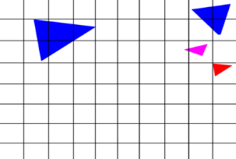
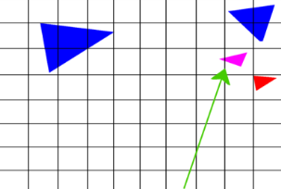
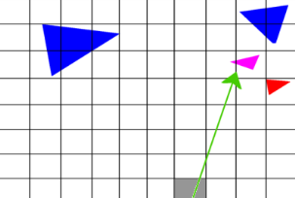
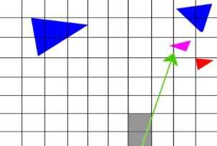
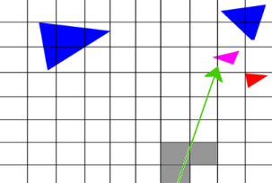
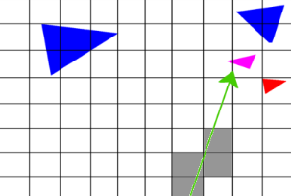
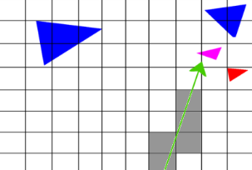
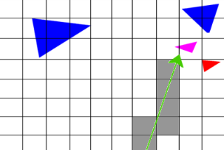
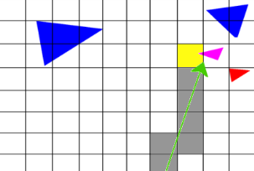
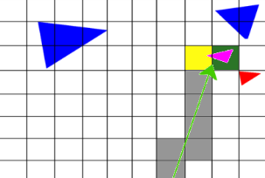
Grids (1/2) – Partitioning Space
Instead of bounding objects bottom-up, break up space into regularly-sized cells
Easy/fast to construct -- great for animated scenes
Can use scanline conversion algorithms for traversal
Think of cells as pixels and ray traversal as scan-converting a line

Slide 12
Grids (2/2) – Pros and Cons
Balance issues: some cells are clearly more important than others
How to determine the best cell size?
A lot of cells have nothing in them; it’s a waste of resources to check them all
Use larger cell sizes?
But then some cells could also have too many objects
Use smaller cell sizes?
Why don’t we just use a finer grid?
Because of the expense of stepping through grid cells during traversal
Analogous to super-sampling from image processing unit: increasing resolution on monitors decreases visible effects of aliasing, but only at the expense of a significant amount of overhead (memory/processing)
Not hierarchical: more traversal time, but less construction time
Useful for animated scenes: moving one object does not affect other objects in grid
In general however, we’d like a smarter, more adaptive solution

Slide 13
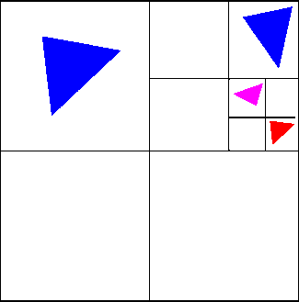
Octrees (1/4) – Adaptive Data Structures
Octrees are based on Warnock’s algorithm for hidden surface removal
project triangles on “screen” and recursively subdivide until the number in a given cell can be clearly solved for occlusion (typically 2)
All nodes in the tree are AABBs (Axis-Aligned Bounding Boxes)
Similar to grid except voxels (3D cells) do not have to be the same size.
Areas with greater density have more voxels
They combine advantages of BVH and grids
Scene agnostic (grids)
Adaptive and hierarchical (BVH)
Viewer independent
2-D example called a quadtree

Slide 14
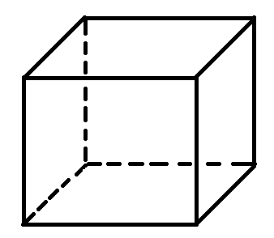
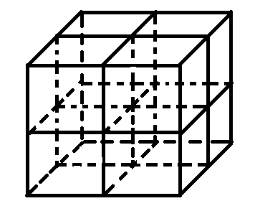
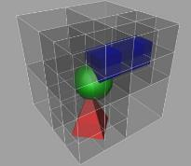
Octrees (2/4) – Construction
Rather than bottom up construction (BVH), construct top down.
Find the bounding box of the entire scene
This is the root of the tree and contains all the primitives
At every iteration, partition the current node into 8 octants
Easy to do if bounding boxes are axis aligned
Split the primitives at the current node into the octants
If a primitive spans both sides of a split, put it in both octants
Recur on the octants
Terminate at a maximum depth or if an octant has sufficiently few primitives

Slide 15
Octrees (3/4) - Traversal
Begin at the root node.
If node is a leaf node, perform intersection on all of its primitives.
Otherwise the node contains child voxels, so iterate through the node’s children and compute intersection between ray and each child’s bounding box.
if it intersects, recur on child again

Slide 16

Octrees (4/4) - Summary
Octrees are able to handle arbitrary scenes with good performance
Expected runtime O(log n) per ray.
Exponential speedup over linear solution
However, for scenes where primitives are distributed very non-uniformly, octrees will perform terribly
Octrees can take many subdivisions to zone in on complex geometry, yielding deeper, inefficient trees
In practice, these scenes are fairly common
What can we do better?

Slide 17
kd-trees (1/6) - Motivation
Let’s be smarter about determining the sizes of nodes in the tree
Tradeoff between spending time intersecting with nodes (deep tree) vs intersecting with scene primitives (shallow tree)
We want to isolate areas of high complexity and cut out large empty spaces, which we can step through quickly during traversal
Solution: kd-tree
Definition: a kd-tree is a k-dimensional, axis-aligned binary tree
Axis-aligned like octree
Binary tree unlike octree - choose one axis to split along at each node
The main challenge with kd-trees used for spatial partitioning is determining where to position the split plane at a given node (including which axis to split along)
Would like splitting plane to adapt to the locations of objects
Degenerate kd-tree is identical to its octree equivalent
Let’s look in-depth at how we would select one split for a single node

Slide 18
kd-trees (2/6) – Choosing a split plane
y=1
0
x=1
Split at middle?
During traversal, ray is equally likely to enter either left side or right side
But cost of entering right side is much higher!
How do we split up this “node” in space optimally?

Slide 19
kd-trees (2/6) – Choosing a split plane
y=1
0
x=1
Split at median?
Cost of entering each side during traversal in terms of possible intersection tests is approximately equal
But a ray is much more likely to enter left-hand side – much greater perimeter!

Slide 20
kd-trees (2/6) – Choosing a split plane
y=1
0
x=1
Cost-Optimized Split
Attempts to balance the cost of entering a node (intersection tests) with probability of entering that node
Isolates geometric complexity rapidly, creating large, empty nodes that can be quickly discarded during traversal

Slide 21
kd-trees (2/6) – Choosing a split plane
y=1
0
x=1
Where to split children?
Left child requires no further subdivision
Right child split roughly at middle/median
No clear winner for future splits in right child; will look mostly like octree from this point onwards (objects now uniformly distributed)
Difference is that we have isolated this geometry after only one split whereas octree would take longer (deeper tree and slower to traverse).

Slide 22
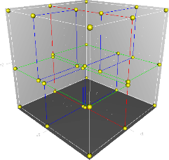
kd-trees (3/6) - Construction
Pseudocode for constructing kd-tree:
Selecting a good split plane is crucial to performance.
Constructing cost-optimal kd-tree is NP-complete, so we do the best we can locally at a given node and use a greedy Surface Area Heuristic as an approximation (next slide)
Given AAB (axis aligned box) of current node and list of primitives L
if there are too few primitives
create leaf node and return
else
choose split axis a (i.e. one of the k dimensions)
choose split plane p (along axis a)
determine which primitives in L intersect left
child and right child respectively
recursively subdivide left child
recursively subdivide right child
►

Slide 23
kd-trees (4/6) – Surface Area Heuristic (1/3)
Pseudocode for construction with SAH:
Pseudo-probability calculation assumes rays will be distributed evenly throughout space
Weight_{child} = ratio of child AAB’s surface area to parent node AAB’s surface area
Cost_{child} = number of primitives contained in child
Weight_{child} * Cost_{child} = Expected cost of entering child node
Number of possible split positions is infinite
Which ones should we consider?
Only consider splits at edges of primitives and edges of the bounding space along the split axis
Given AAB of current node and list of primitives L
for each possible split position (see next slide)
cost = Weight_{left} * Cost_{left} + Weight_{right} * Cost_{right}
use split plane which minimizes this cost

Slide 24






kd-trees (4/6) – Surface Area Heuristic (2/3)
8
Try splitting at the edge of each object:
y
0
x
s1
s2
s3
6
s4
s5
10
(Since this example is in 2D, “surface area” is the perimeter of each bounding rectangle)
s6

Slide 25
kd-trees (4/6) – Surface Area Heuristic (3/3)
Complexity analysis: do high construction costs nullify the advantage we gain during traversal?
Naïve construction takes O(n² log n)
How can we make construction faster?
Sort primitives along split axis, iterate through until surface area heuristic is met
Takes O(n log² n)
Memory is generally the limiting factor

Slide 26
kd-trees (5/6) - Traversal
Can use identical traversal algorithm as for octrees
Early termination:
Instead of traversing the two children in arbitrary order, pick the child that will be hit by the ray first.
First child is called the “frontside child”
Second child is the “backside child”
If there is an intersection in the frontside child that is earlier than the intersection to the backside child’s bounding box, no need to traverse backside child
This technique also applies for previous data structures

Slide 27
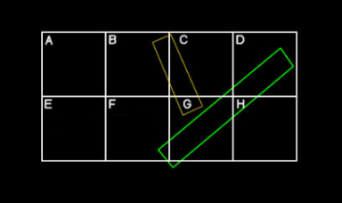
kd-trees (6/6) – Edge Cases
Traversal edge cases – must be really careful when early termination is safe
The ray traverses node F before node G. When traversing F, the ray tries to intersect with the big rectangle.
However, the ray/big rectangle intersection is not in F, so you cannot terminate yet.
Must compare intersection t values with t values for bounding boxes.
During construction, what happens if the primitive is in the split plane?
Choose one?
No, put object in both sides
Rays that are inside/parallel to split plane
Look out for divide by zero!

Slide 28
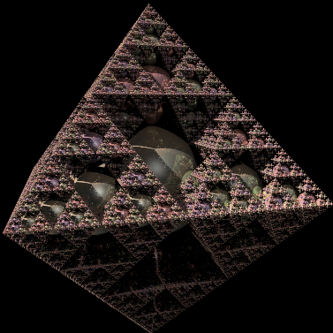
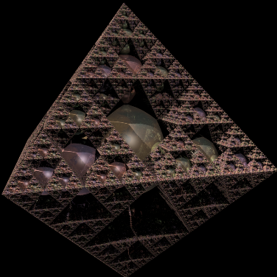
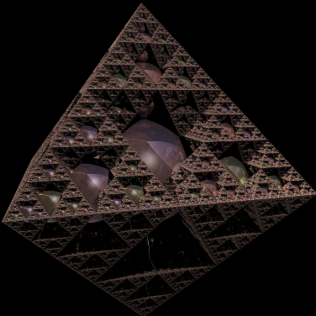
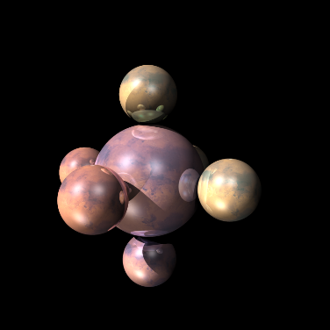
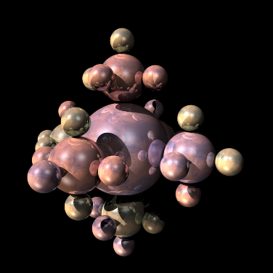
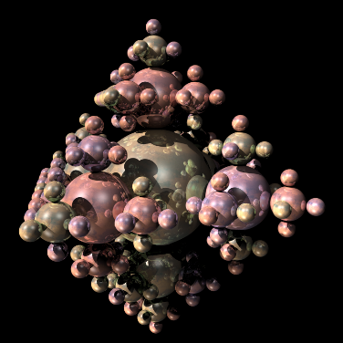
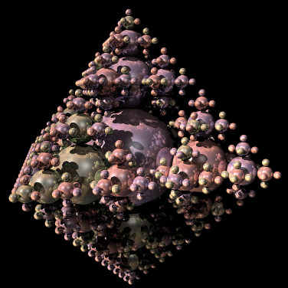
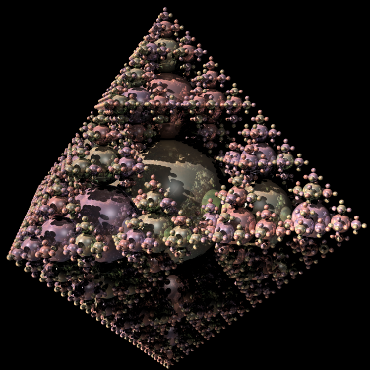
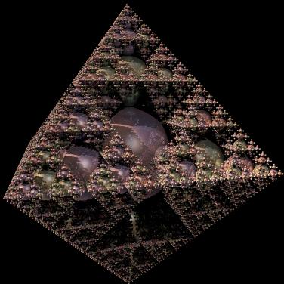
Example
Recursive Spheres 7 : 23437 spheres
KD tree build time : 21.2 s
KD tree render time : 11.8 s
No tree render time : 1653.1 s (27 m 33 s)
These images and calculations were done by past TAs using their raytracing code

Slide 29
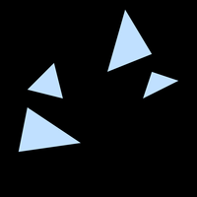

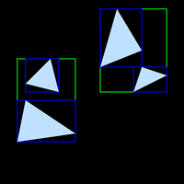


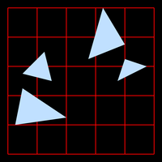
Summary of Acceleration Data Structures (1/2)
Bounding Volume Hierarchy
Grids

Slide 30


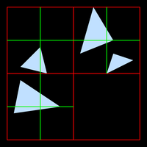


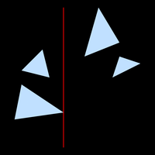


Summary of Acceleration Data Structures (2/2)
Octrees
kd-tree

Slide 31
BSP Trees
Binary space partitioning trees, or BSP trees for short, exist as two noticeably diﬀerent variants in computer graphics, which we call axis-aligned and polygon-aligned. The trees are created by using a plane to divide the space in two, and then sorting the geometry into these two spaces. This division is done recursively. One worthwhile property is that if a BSP tree is traversed in a certain way, the geometrical contents of the tree can be sorted front to back from any point of view. This sorting is approximate for axis-aligned and exact for polygon-aligned BSPs. Note that the axis-aligned BSP tree is also called a k-d tree.

Slide 32
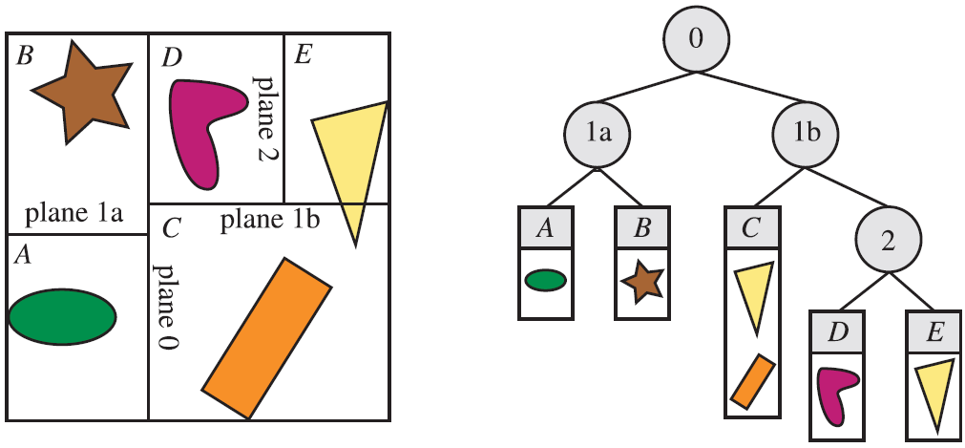
Axis-Aligned BSP Trees(k-DTrees)
An axis-aligned BSP tree is created as follows. First, the whole scene is enclosed
in an axis-aligned bounding box (AABB). The idea is then to recursively subdivide
this box into smaller boxes. Now, consider a box at any recursion level. One axis
of the box is chosen, and a perpendicular plane is generated that divides the space
into two boxes. Some schemes ﬁx this partitioning plane so that it divides the box
exactly in half; others allow the plane to vary in position.
Axis-aligned BSP tree. In this example, the space partitions are allowed to be any where along the axis, not just at its midpoint. The spatial volumes formed are labeled A through E. The tree on the right shows the underlying BSP data structure. Each leaf node represents an area, with that area’s contents shown beneath it. Note that the triangle is in the object list for two areas, C and E, because it overlaps both.

Slide 33
Axis-Aligned BSP Trees(k-DTrees)
Rough front-to-back sorting is an example of how axis-aligned BSP trees can be
used. This is useful for occlusion culling algorithms, as well as for generally reducing pixel shader costs by minimizing pixel overdraw.
Assume that a node called N is currently traversed. Here, N is the root at the start of traversal. The splitting plane of N is examined, and tree traversal continues recursively on the side of the plane where the viewer is located. Thus, it is only when the entire half of the tree has been traversed that we start to traverse the other side. This traversal gives a rough sorting, which often is useful. By starting traversal on the other side of a node’s plane when compared to the viewer’s position, rough back-to-front sorting can be obtained. This is useful for transparency sorting.
BSP traversal can also be used to test a ray against the scene geometry. The ray’s origin is simply exchanged for the viewer’s location.

Slide 34
Polygon-Aligned BSP Trees
The other type of BSP tree is the polygon-aligned form . This data structure is particularly useful for rendering static or rigid geometry in an exact sorted order. This algorithm was popular for games like DOOM, back when there was no hardware z-buﬀer. It still has occasional use, such as for collision detection and intersection testing.
In this scheme, a polygon is chosen as the divider, splitting space into two halves.
That is, at the root, a polygon is selected. The plane in which the polygon lies
is used to divide the rest of the polygons in the scene into two sets. Any polygon
that is intersected by the dividing plane is broken into two separate pieces along the
intersection line. Now in each half-space of the dividing plane, another polygon is
chosen as a divider, which divides only the polygons in its half-space. This is done
recursively until all polygons are in the BSP tree.

Slide 35
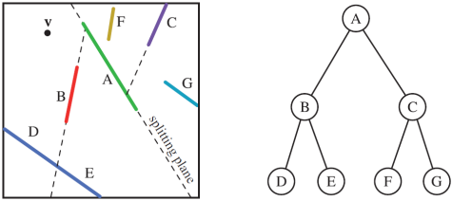
Polygon-Aligned BSP Trees
Polygon-aligned BSP tree. Polygons A through G are shown from above. Space is ﬁrst split by polygon A, then each half-space is split separately by B and C. The splitting plane formed
by polygon B intersects the polygon in the lower left corner, splitting it into separate polygons D and E. The BSP tree formed is shown on the right.
For a given view, the structure can be traversed strictly from back to front (or front to back). For example, consider what is seen by a viewer v in the Figure. Regardless of the viewing direction and frustum, v is to the left of the splitting plane formed by A, so C, F, and G are behind B, D,and E. Comparing v to the splitting plane of C, we ﬁnd G to be on the opposite side of this plane, so it is displayed ﬁrst. A test of B’s plane determines that E should be displayed before D. The back-to-front order is then G,C,F,A,E,B,D.

Slide 36
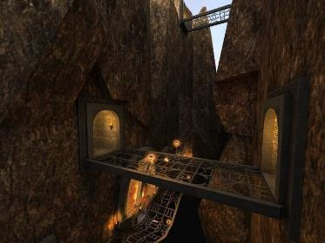
BSP Trees
kd-tree visited nodes front-to-back during ray tracing traversal
BSP nodes visited in back to front order for standard polygon rendering. The back child of a node is the side that doesn’t contain the viewpoint (view-dependent).
Very fast to build. Quake III uses this for occlusion culling and to speed up collision testing

Slide 38
BSP Trees (8/8)
void BSP_displayTree(BSP_tree* tree) {
if ( tree is not empty )
if ( viewer is in front of root ) {
BSP_displayTree(tree->backChild);
displayPolygon(tree->root);
BSP_displayTree(tree->frontChild);
}
else {
BSP_displayTree(tree->frontChild);
// ignore next line if back-face
// culling desired
displayPolygon(tree->root);
BSP_displayTree(tree->backChild);
}
}
}

Slide 39
Quiz
Which data structure(s) are best-suited in the following situations?
An animation where only the camera moves?
kd-tree
BSP-tree
A fast-paced video game with lots of interactive, moving objects?
Grid
A very balanced and even scene with objects uniformly distributed throughout the whole scene?
Octree

Slide 40
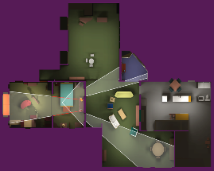
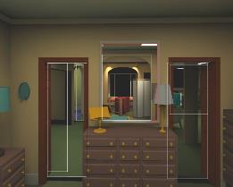
Advanced Techniques (1/2) - Portals
Indoor spaces are mostly rooms with doorways
Why draw the geometry in the next room if the door is closed?
If there is a portal (open door or hallway) only need to draw geometry visible through the door
Determining this information is useful as a pre-computation step – geometry visible through a portal remains constant. Not too good for outdoor scenes
Picture Courtesy: David P. Luebke and Chris Georges, “Simple, Fast Evaluation of Potentially Visible Sets”

Slide 41
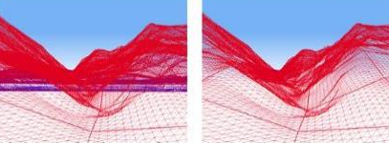
Advanced Techniques (2/2) – Occlusion Culling
If a big object fills a good portion of the screen, don’t draw geometry that it covers up
Many new graphics cards have support for parts of the process
Algorithm:
Create list of all objects potentially visible in frustum (per polygon or per shape)
For each pair of objects i and j, if i occludes j (i.e. j lies in i’s shadow volume) remove j
O(n²)! Lots of ways to make this faster:
Coorg, S., and S. Teller, "Real-Time Occlusion Culling for Models with Large Occluders", in 1997 Symposium on Interactive 3D Graphics
Gamasutra overview of Occlusion Culling algorithms: http://www.gamasutra.com/view/feature/3394/occlusion_culling_algorithms.php
State of the art: https://software.intel.com/en-us/articles/masked-software-occlusion-culling
Bad for indoor scenes with lots of small objects
Without OC – lots of geometry drawn, most is not seen (drawn in blue)
With OC – algorithm ignores blue geometry behind the hills

